Slide 1

Complex Network Construction for Interactive Image Segmentation using Particle Competition and Cooperation: A New Approach
Jefferson A. R. Passerini and Fabricio Breve
Fabricio Breve
São Paulo State University (UNESP)
fabricio.breve@unesp.br
July 3, 2020
1

Slide 2
Particle Competition and Cooperation
Particle competition and cooperation (PCC) is a graph-based semi-supervised learning method.
The dataset is converted into a non-weighted and non-orientated graph:
  Each data item corresponds to a node;
  Edges are generated from the similarity relations between the data items.
Particles, which correspond to the labeled data, move in the graph cooperating with other particles of the same class and competing against particles of other classes.
  To dominate as many nodes as possible.
4
2. Breve, F., Zhao, L., Quiles, M., Liu, J., Pedrycz, W.: Particle competition and cooperation in networks for semi-supervised learning. Knowledge and Data Engineering (24(9)), 1686–1698 (2012)
J. A. R. Passerini and F. Breve

Slide 3
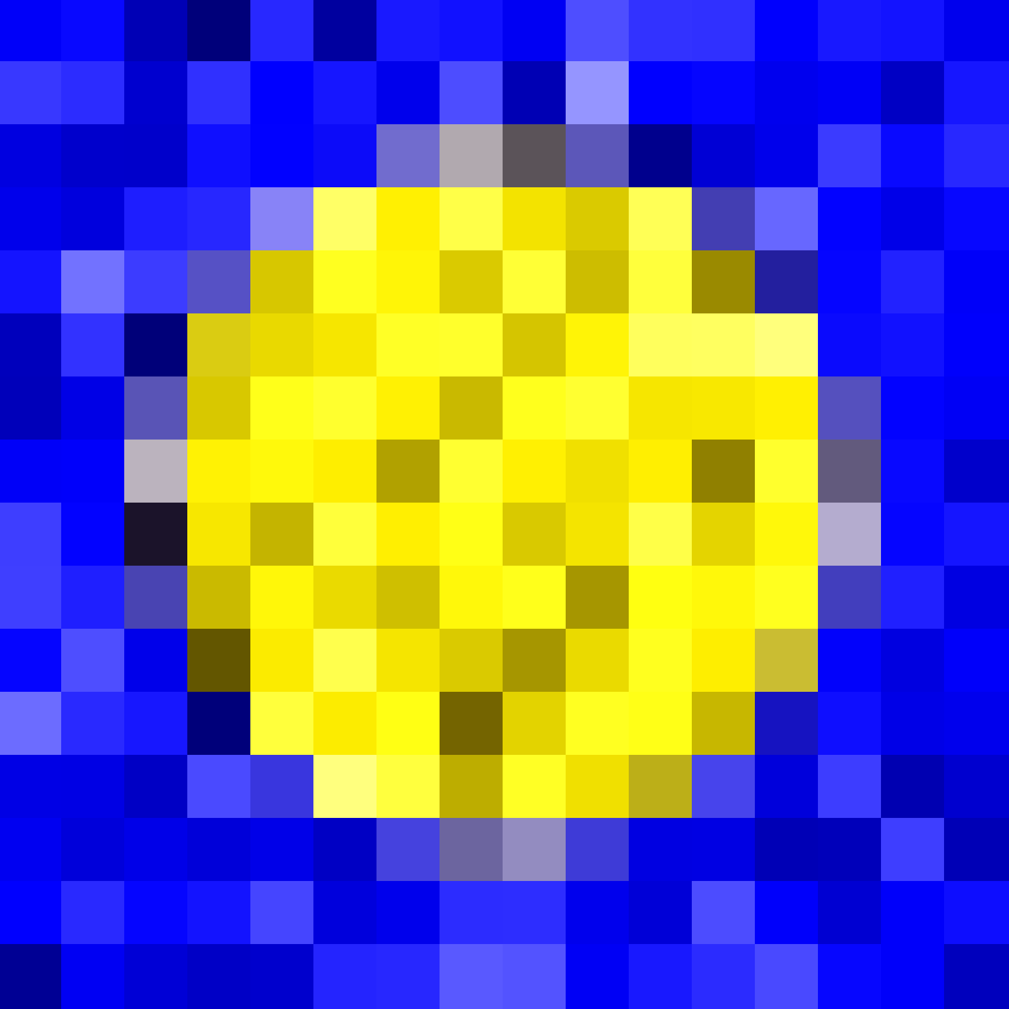
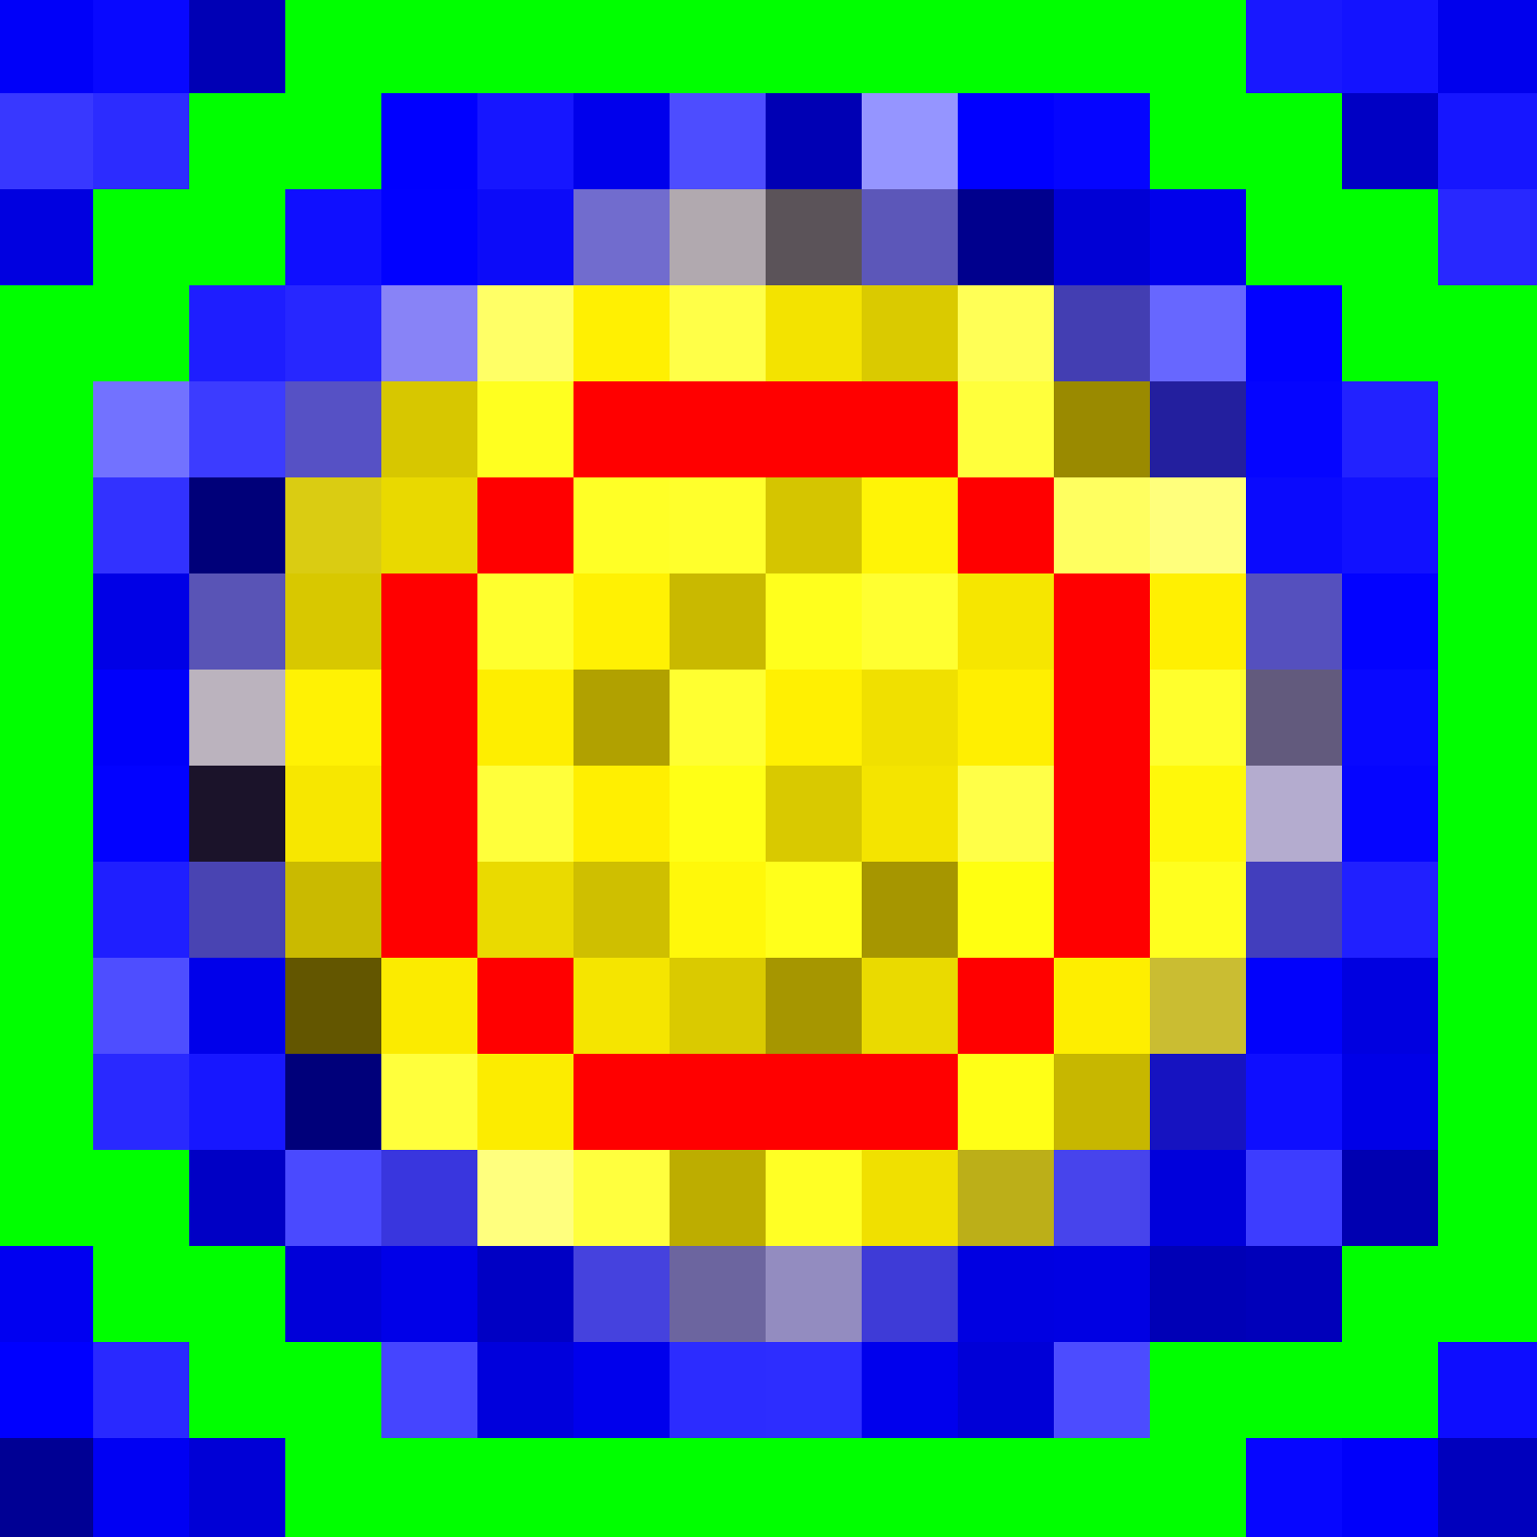
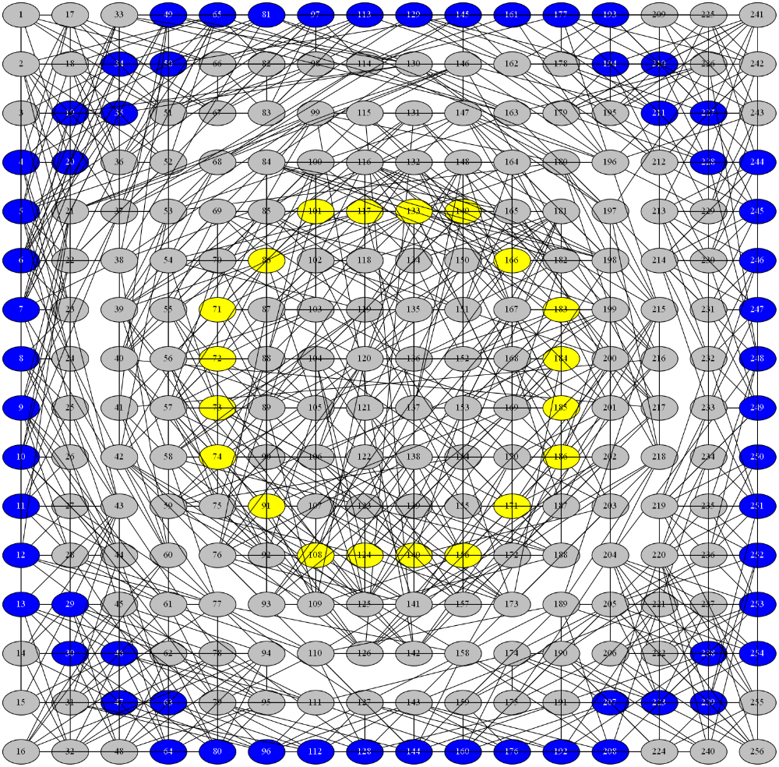
PCC applied to Interactive Image Segmentation
The complex network is build based on the image to be segmented:
  Each pixel is represented as a node;
  The pixels labeled by the user are also represented as particles;
  The edges are defined according to the similarity between each pair of pixels, measured by the Euclidean distance among features extracted from them:
    RGB and HSV components;
    Pixel localization.
3. Breve, F., Quiles, M.G., Zhao, L.: Interactive Image Segmentation using Particle Competition and Cooperation. Lecture Notes in Computer Science 9155, 203–216 (10 2015).
J. A. R. Passerini and F. Breve

Slide 4
Motivation of the New Approach
In the previous approach, a weight vector must be defined for each image:
  According to their discriminative capacity in the image to be segmented;
  It has a big impact on the PCC segmentation accuracy.
Methods to automatically define the weight vector had limited success:
  Works in some images, fails in others [7];
  Time-consuming optimization process [8].
7. Breve, F.A.: Auto Feature Weight for Interactive Image Segmentation using Particle Competition and Cooperation. In: Proceedings - XI Workshop de Visão
Computacional WVC2015. pp. 164–169. XI Workshop de Visão Computacional (WVC2015) (10 2015).
8. Breve, F.A.: Building Networks for Image Segmentation Using Particle Competition and Cooperation. In: Gervasi O. et al (eds) Computational Science and Its
Applications, ICCSA 2017, International Conference, Proceedings. vol. 10404, pp. 217–231. Springer International Publishing (2017).
J. A. R. Passerini and F. Breve

Slide 5
The New Approach
We propose the elimination of the weight vector through:
  a different set of features;
  a new form of user annotation;
  a new approach to define the edges among network nodes;
  the particle influence on the network being measured before the competition process starts.
J. A. R. Passerini and F. Breve

Slide 6
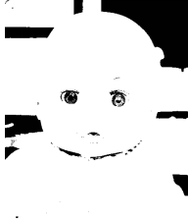
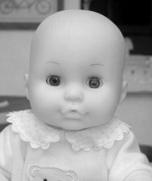
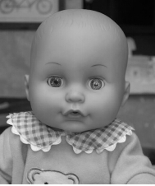
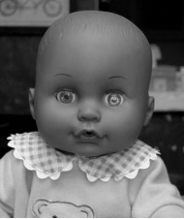

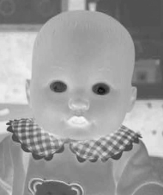
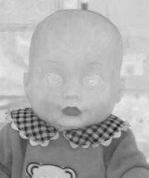

New Set of Features
The new set uses less features than its predecessors:
  (1-2) pixel location components (line, column)
  (3-5) RGB components
  (6) only the V (value) component of the HSV system
  (7-9) the color components ExR, ExG, ExB
  (10) a new feature extracted using Otsu’s binarization algorithm
Otsu’s
R
G
B
V
ExR
ExG
ExB
J. A. R. Passerini and F. Breve

Slide 7
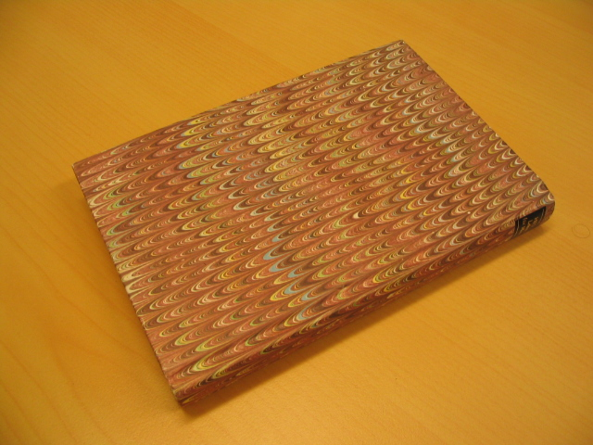
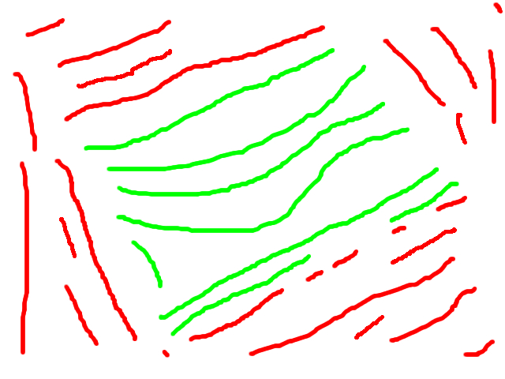

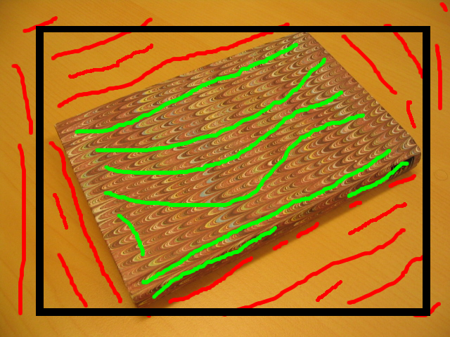
New Form of User Annotation
In this new approach, it possible to delimit, in the image, the region of interest where the object to be segmented is found to reduce the processing scope.
Real-world images to be segmented
“Scribbles” provided by the user
Cut polygon provided by the user
Overlay image (visualization only)
J. A. R. Passerini and F. Breve

Slide 8
New Approach to Define the Edges among Network Nodes
Reference model: each node is connected to its k-nearest neighbors, considering the Euclidean distance among pixel features
  k is set by the user.
Proposed model: k is fixed, each node is connected to its 192 nearest neighbors.
  Another 8 connections are made based in the pixel spatial neighborhood, defined by a 3x3 window
    the node will be linked to the nodes corresponding to its 8 physically adjacent pixels.
J. A. R. Passerini and F. Breve

Slide 9
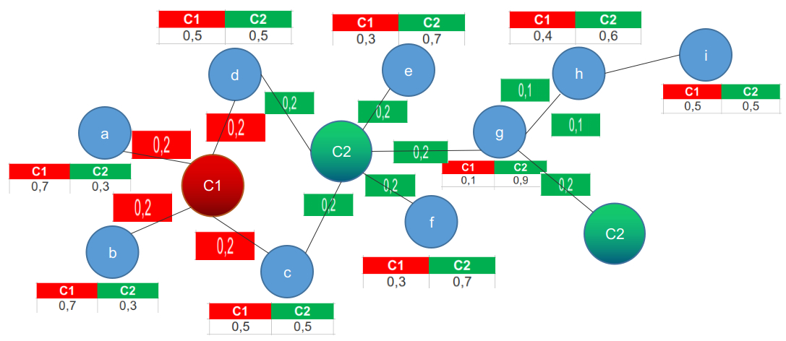
Particle Influence on the Network
A particle (labeled pixel) influences nearby nodes in the network.
Unlabeled nodes nearby labeled nodes will have an increment in their domination level of the particle’s class:
  1 hop away = +0.2
  2 hops away = +0.1
J. A. R. Passerini and F. Breve

Slide 10
Experiments
151 real-world images taken from the GrabCut dataset, the PASCAL VOC dataset, and from the Alpha matting dataset are used to evaluate both models.
  The weight vector λ was defined so all the features had the same weight.
  The markings (labels) defined for the tests and the cut polygons used in this work are available at Github¹.
  Each image is evaluated 30 times and the average is taken.
¹ https://github.com/jeffersonarpasserini/dataset-interactive-algorithms.git
J. A. R. Passerini and F. Breve

Slide 11
Results
Error rates in the five images that did not use the cut polygon resource:
Image Name | Proposed | Reference
Baby_2007_006647 | 1.17% | 4.57%
cross | 0.48% | 1.79%
gt02 | 0.52% | 1.27%
gt07 | 0.21% | 0.64%
gt13 | 1.08% | 2.11%
Average | 0.64% | 1.72%
J. A. R. Passerini and F. Breve

Slide 12
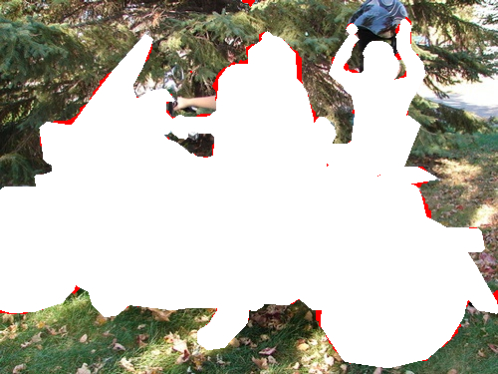
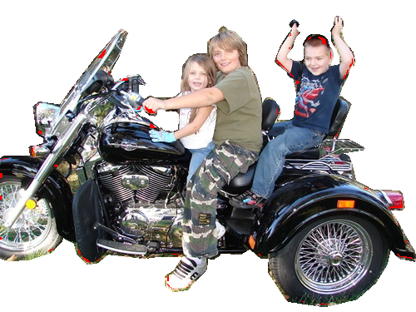
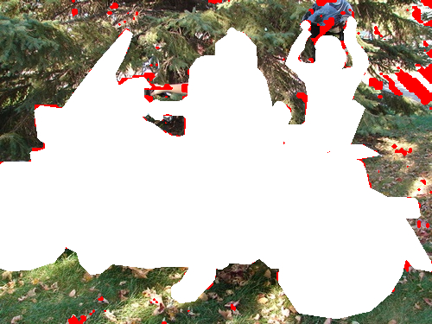
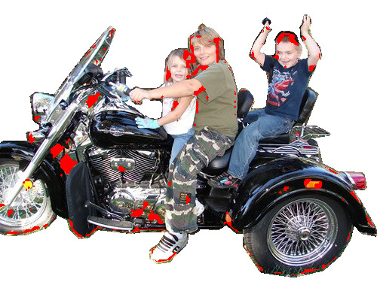
Results
Proposed Model – Error Rate: 1.17%
Reference Model – Error Rate: 4.57%
J. A. R. Passerini and F. Breve

Slide 13
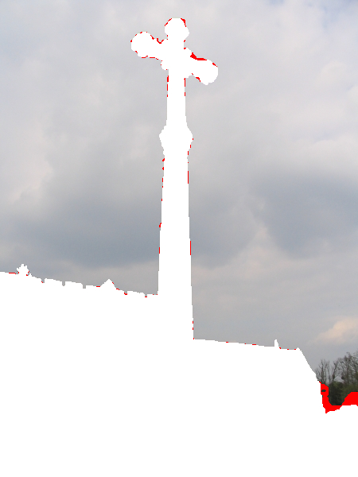
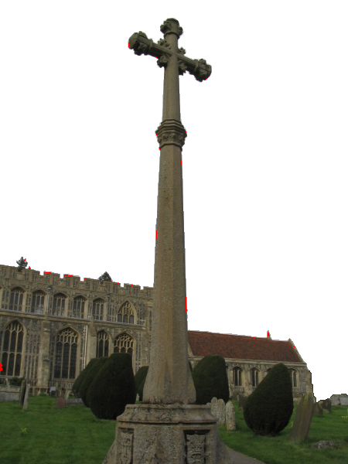
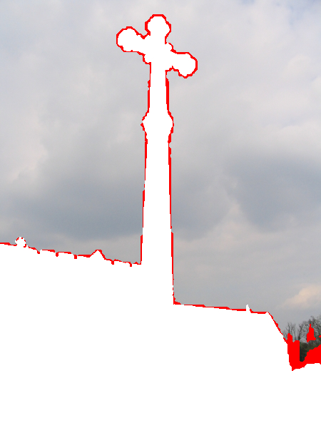

Results
Proposed Model
Error Rate: 0.48%
Reference Model
Error Rate: 1.79%
J. A. R. Passerini and F. Breve

Slide 14
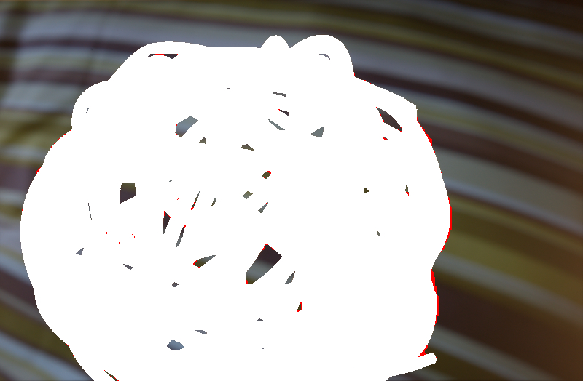
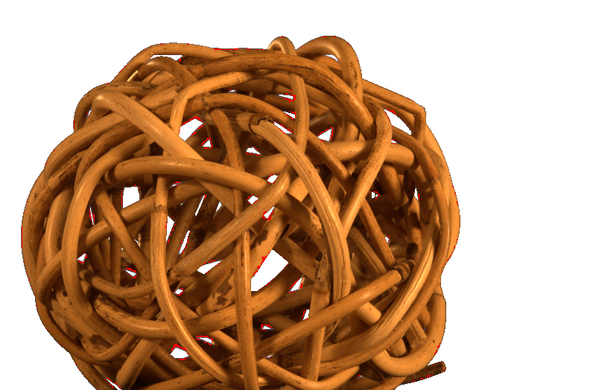
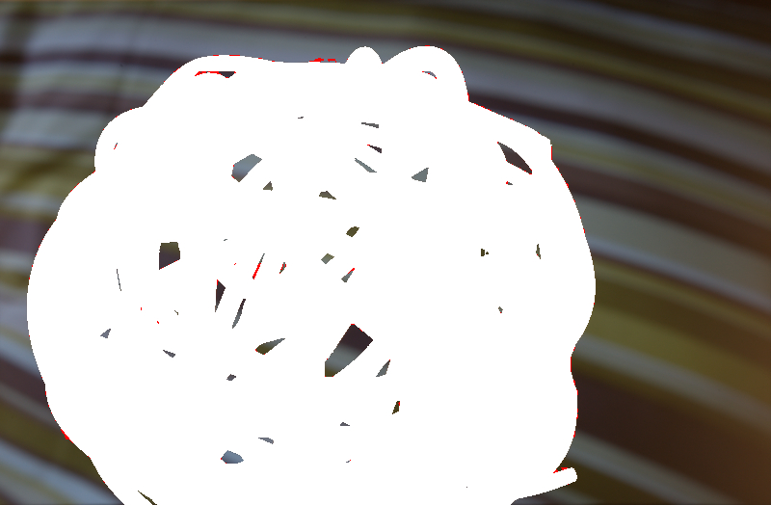

Results
Proposed Model – Error Rate: 0.52%
Reference Model – Error Rate: 1.27%
J. A. R. Passerini and F. Breve

Slide 15

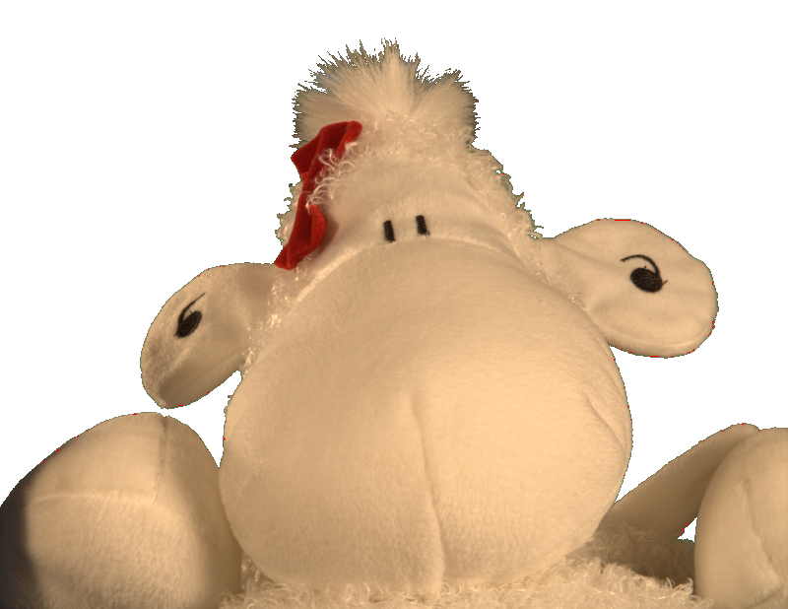
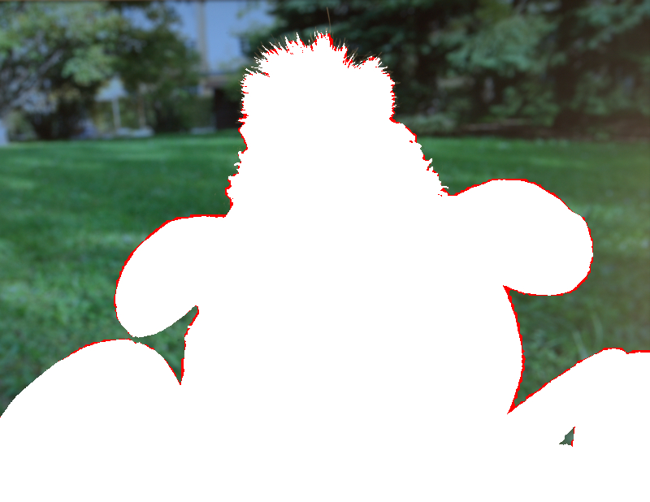

Results
Proposed Model – Error Rate: 0.21%
Reference Model – Error Rate: 0.64%
J. A. R. Passerini and F. Breve

Slide 16
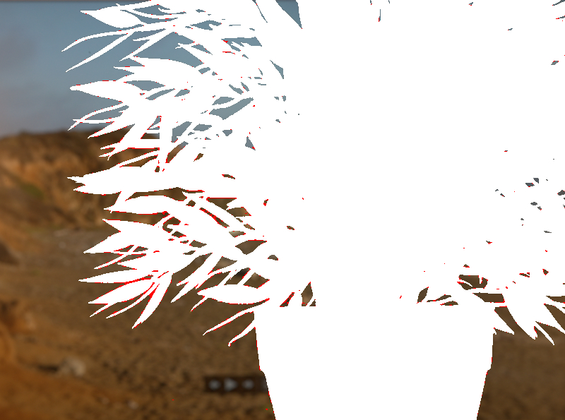
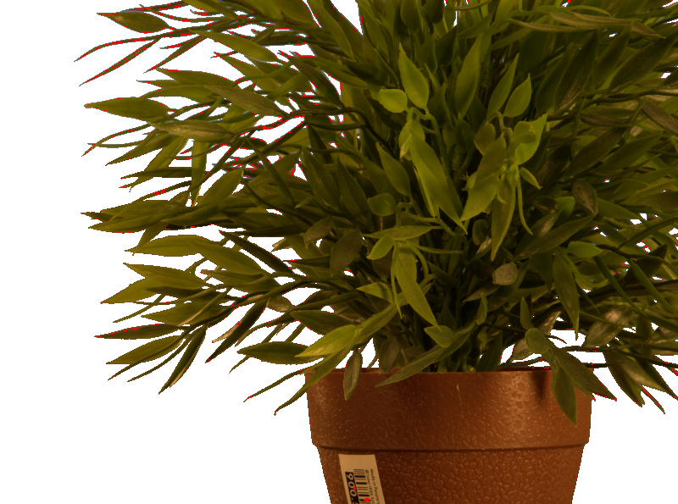
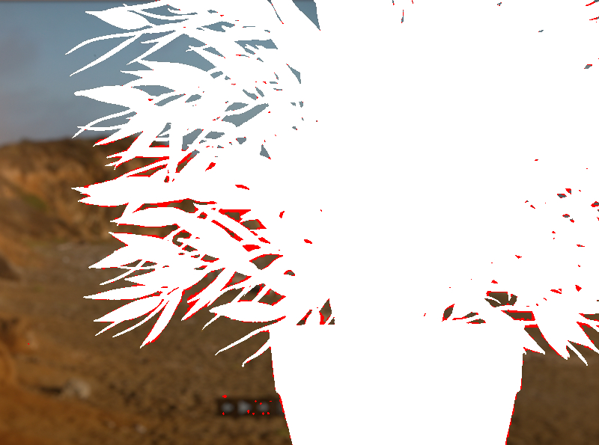

Results
Proposed Model – Error Rate: 1.08%
Reference Model – Error Rate: 2.11%
J. A. R. Passerini and F. Breve

Slide 17
Results
Error rates in the images with the lowest error rates achieved by the proposed method.
Image Name | Proposed | Reference
Monitor_2007_003011 | 0.02% | 1.09%
Train_2007_004627 | 0.09% | 0.76%
Car_2008_001716 | 0.10% | 2.51%
Monitor_2007_004193 | 0.11% | 3.00%
Person_2007_002639 | 0.12% | 2.47%
Average | 0.08% | 1.94%
J. A. R. Passerini and F. Breve

Slide 18
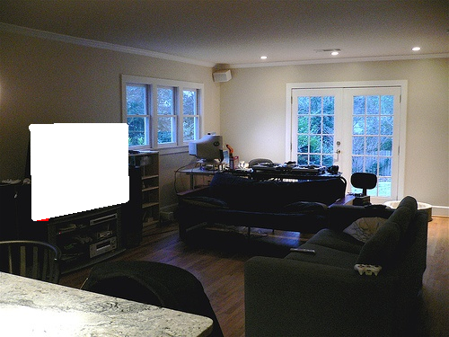
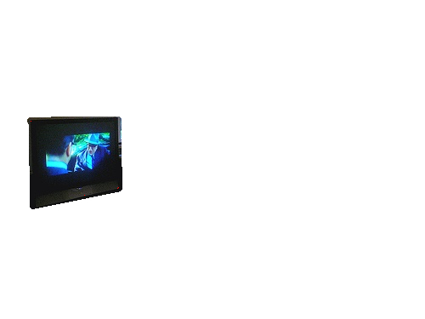

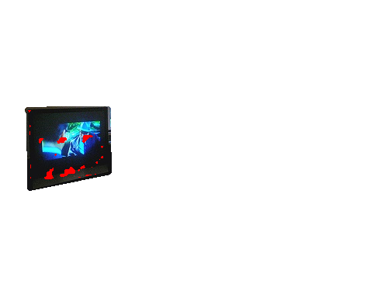
Results
Proposed Model – Error Rate: 0.02%
Reference Model – Error Rate: 1.09%
J. A. R. Passerini and F. Breve

Slide 19
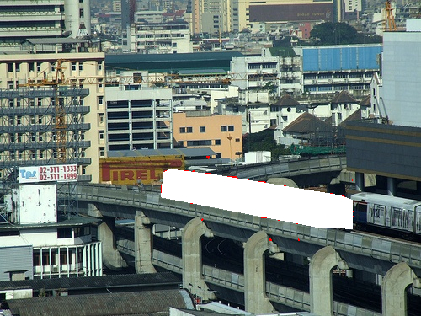
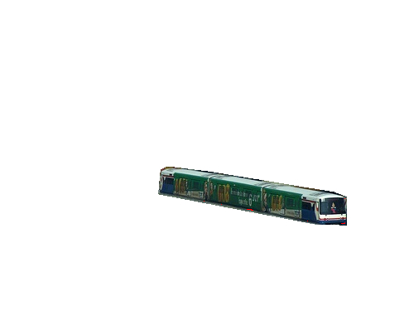
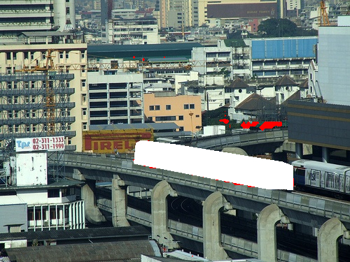
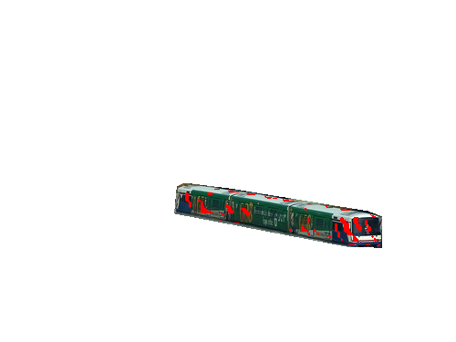
Results
Proposed Model – Error Rate: 0.09%
Reference Model – Error Rate: 0.76%
J. A. R. Passerini and F. Breve

Slide 20
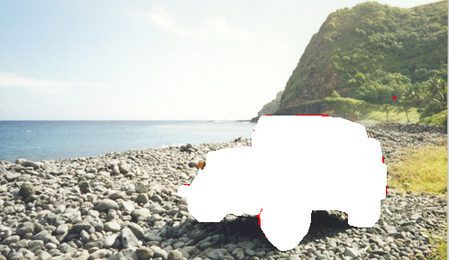
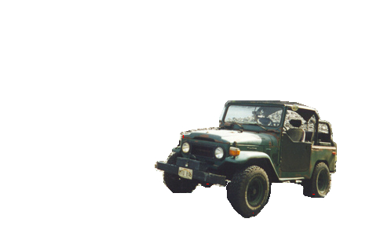
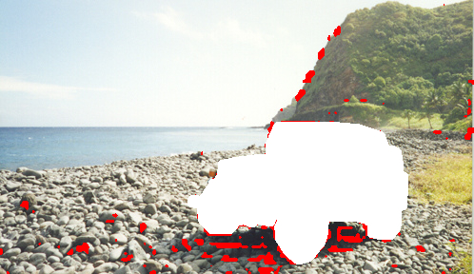
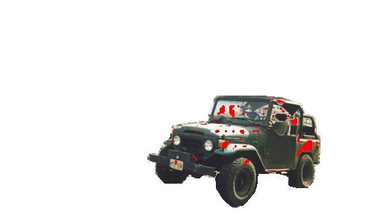
Results
Proposed Model – Error Rate: 0.10%
Reference Model – Error Rate: 2.51%
J. A. R. Passerini and F. Breve

Slide 21
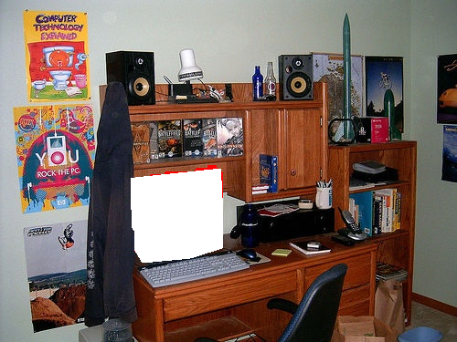
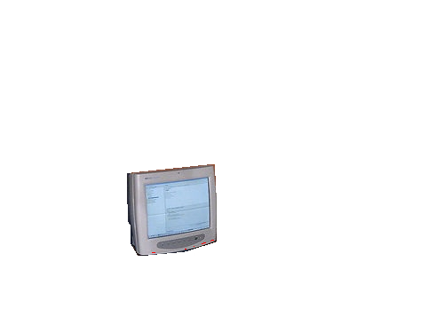
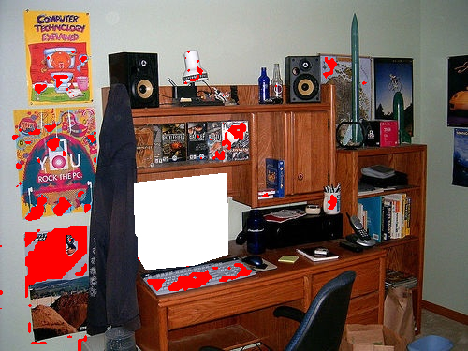

Results
Proposed Model – Error Rate: 0.11%
Reference Model – Error Rate: 3.00%
J. A. R. Passerini and F. Breve

Slide 22
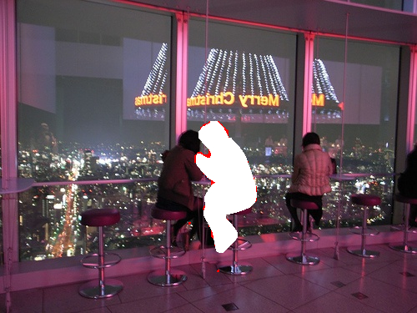
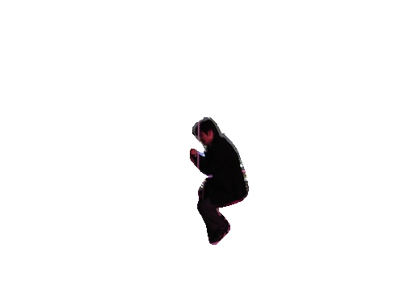
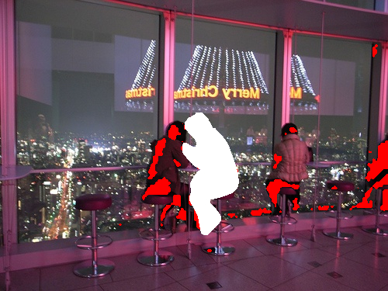
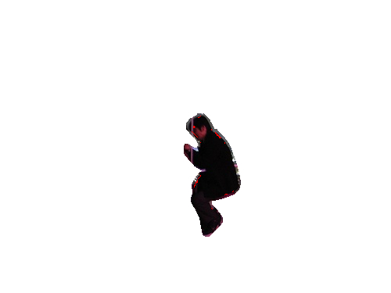
Results
Proposed Model – Error Rate: 0.12%
Reference Model – Error Rate: 2.47%
J. A. R. Passerini and F. Breve

Slide 23
Results
Generated complex networks average characteristics
Method | # Pixels |  | Characteristics
 | All | Unlabeled | Particles | Nodes | Edges
Proposed | 200,124 | 2,783 | 2,860 | 7,538 | 838,564
Reference | 200,124 | 2,783 | 5,487 | 17,946 | 2,354,555
Average error rate and execution time
Method | Error Rate | Time (s)
Proposed | 0.49% | 432.54
Reference | 3.14% | 1082.94
J. A. R. Passerini and F. Breve

Slide 24
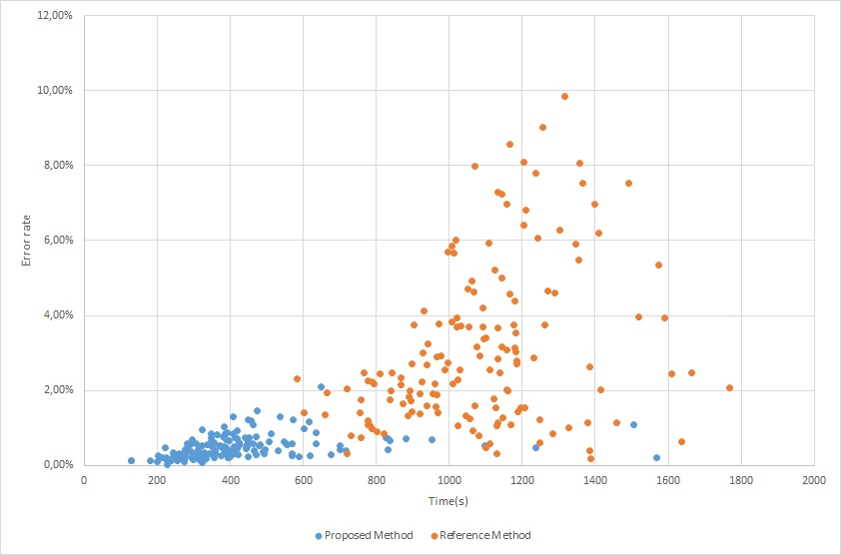
Relation Analysis between error rate and processing time
J. A. R. Passerini and F. Breve

Slide 25
Conclusions
This paper presented a methodology to improve the automation level, accuracy and performance of the particle competition and cooperation model for image segmentation:
  Elimination of the weight vector (parameter set by the user, requiring expertise);
  Optimization of the network construction phase;
  No changes in the particle competition and cooperation step;
  Average error rate of only 0.49% vs. 3.14% of the reference model;
  Faster processing. Average time of 432.54 seconds vs. 1082.94 seconds of the reference model.
J. A. R. Passerini and F. Breve

Slide 26
Complex Network Construction for Interactive Image Segmentation using Particle Competition and Cooperation: A New Approach
Jefferson A. R. Passerini and Fabricio Breve
Fabricio Breve
São Paulo State University (UNESP)
fabricio.breve@unesp.br
July 3, 2020
26

