Slide 1
Uncovering Overlap Community Structure in Complex Networks using Particle Competition
International Conference on Artificial Intelligence and Computational Intelligence - AICI'09
Fabricio A. Breve fabricio@icmc.usp.br
Liang Zhao zhao@icmc.usp.br
Marcos G. Quiles quiles@icmc.usp.br
Department of Computer Science. Institute of Mathematics and Computer Science. University of São Paulo. São Carlos-SP. Brazil

Slide 2
Contents
Introduction
  Overlap Community Structure
Model Description
  Initial Configuration
  Node and Particle Dynamics
  Random-Deterministic Walk
  Fuzzy Output
  Algorithm
Computer Simulations
  Synthetic Networks
  Real-World Network
Conclusions

Slide 3
Introduction
Communities are defined as a subgraph whose nodes are densely connected within itself but sparsely connected with the rest of the network.
However, in practice there are common cases where some nodes in a network can belong to more than one community.
  Example: in a social network of friendship, individuals often belong to several communities:
    their families,
    their colleagues,
    their classmates,
    etc.
  These nodes are called overlap nodes, and most known community detection algorithms cannot detect them
  Uncovering the overlapping community structure of complex networks becomes an important topic in data mining. [1 – 3]
Zhang, S.,Wang, R.S., Zhang, X.S.: Identication of overlapping community structure in complex networks using fuzzy c-means clustering. Physica A Statistical Mechanics and its Applications 374 (January 2007) 483-490.
Palla, G., Derenyi, I., Farkas, I., Vicsek, T.: Uncovering the overlapping community structure of complex networks in nature and society. Nature 435(7043) (2005) 814-818 .
Zhang, S., Wang, R.S., Zhang, X.S.: Uncovering fuzzy community structure in complex networks. Physical Review E (Statistical, Nonlinear, and Soft Matter Physics) 76(4) (2007) 046103.

Slide 4
Proposed Method
Particles competition
  For possession of nodes of the network
  Rejecting intruder particles
Objectives
  Detect community structure
  Uncover overlap community structure

Slide 5
Initial Configuration
A particle is generated for each community to be detected
Nodes have an ownership vector
  Initially, nodes have levels set equally for each particle
    Ex: [ 0.25 0.25 0.25 0.25 ] (4 classes)
Particles initial position is set randomly.

Slide 6
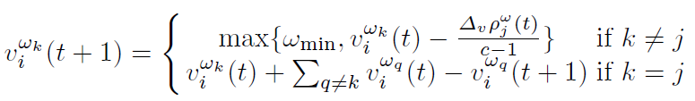
Node Dynamics
When a particle selects a neighbor to visit:
  It decreases the ownership level of other particles
  It increases its own ownership level

Slide 7
Particle Dynamics
A particle will get:
  stronger when it is targeting a node being dominated by it
  weaker when it is targeting a node dominated by other particles

Slide 8
Particles Walk
Shocks
  A particle really visits a target node only if its ownership level on that node is higher than others;
  otherwise, a shock happens and the particle stays at the current node until next iteration.
How a particle chooses a neighbor node to target?
  Random walk
  Deterministic walk

Slide 9


Random-deterministic walk
  Random walk
    The particle randomly chooses any neighbor to visit with no concern about ownership levels
  Deterministic walk
    The particle will prefer visiting nodes that it already dominates
The particles must exhibit both movements in order to achieve an equilibrium between exploratory and defensive behavior

Slide 11

Fuzzy Output
Instantaneous ownership levels
  Very volatile under certain conditions
    In overlap nodes the dominating team changes frequently
    Levels do not correspond to overlap measures
Long-term ownership levels
  Temporal averaged domination level for each team at each node
    Weighted by particle strength
    Considers only the random movements

Slide 12
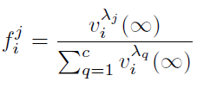
Fuzzy Output
At the end of the iterations, the degrees of membership for each node are calculated using the long term ownership levels

Slide 13
Algorithm
Build the adjacency matrix,
Set nodes domination levels,
Set initial positions of particles randomly and set particle strength
Repeat steps 5 to 8 until convergence or until a predefined number of steps has been achieved,
For each particle, complete steps 6 to 8,
Select the target node by using the combined random-deterministic rule,
Update target node domination levels,
Update particle strength,
Calculate the membership levels (fuzzy classication) based on long-term ownership levels

Slide 14
Computer Simulations

Slide 15
Connections | Fuzzy Classification
A-B-C-D | A | B | C | D
16-0-0-0 | 0.9928 | 0.0017 | 0.0010 | 0.0046
15-1-0-0 | 0.9210 | 0.0646 | 0.0079 | 0.0065
14-2-0-0 | 0.8520 | 0.1150 | 0.0081 | 0.0248
13-3-0-0 | 0.8031 | 0.1778 | 0.0107 | 0.0084
12-4-0-0 | 0.7498 | 0.2456 | 0.0032 | 0.0014
11-5-0-0 | 0.6875 | 0.3101 | 0.0016 | 0.0008
10-6-0-0 | 0.6211 | 0.3577 | 0.0111 | 0.0101
9-7-0-0 | 0.5584 | 0.4302 | 0.0011 | 0.0103
8-8-0-0 | 0.4949 | 0.4944 | 0.0090 | 0.0017
8-4-4-0 | 0.5025 | 0.2493 | 0.2461 | 0.0021
7-4-4-1 | 0.4397 | 0.2439 | 0.2491 | 0.0672
6-4-4-2 | 0.3694 | 0.2501 | 0.2549 | 0.1256
5-4-4-3 | 0.3144 | 0.2491 | 0.2537 | 0.1828
4-4-4-4 | 0.2512 | 0.2506 | 0.2504 | 0.2478
Table 1. Fuzzy classification of a node connected to network with 4 communities generated with z_{out}/k = 0.125

Slide 16
Connections | Fuzzy Classification
A-B-C-D | A | B | C | D
16-0-0-0 | 0.9912 | 0.0027 | 0.0024 | 0.0037
15-1-0-0 | 0.9318 | 0.0634 | 0.0026 | 0.0023
14-2-0-0 | 0.8715 | 0.1219 | 0.0023 | 0.0044
13-3-0-0 | 0.8107 | 0.1827 | 0.0036 | 0.0030
12-4-0-0 | 0.7497 | 0.2437 | 0.0044 | 0.0022
11-5-0-0 | 0.6901 | 0.3036 | 0.0034 | 0.0029
10-6-0-0 | 0.6298 | 0.3654 | 0.0020 | 0.0028
9-7-0-0 | 0.5584 | 0.4360 | 0.0026 | 0.0030
8-8-0-0 | 0.4952 | 0.4985 | 0.0027 | 0.0036
8-4-4-0 | 0.5060 | 0.2485 | 0.2427 | 0.0028
7-4-4-1 | 0.4442 | 0.2477 | 0.2429 | 0.0652
6-4-4-2 | 0.3762 | 0.2465 | 0.2514 | 0.1259
5-4-4-3 | 0.3178 | 0.2500 | 0.2473 | 0.1849
4-4-4-4 | 0.2470 | 0.2518 | 0.2489 | 0.2523
Table 2. Fuzzy classification of a node connected to network with 4 communities generated with z_{out}/k = 0.250

Slide 17
Connections | Fuzzy Classification
A-B-C-D | A | B | C | D
16-0-0-0 | 0.9709 | 0.0092 | 0.0108 | 0.0091
15-1-0-0 | 0.9160 | 0.0647 | 0.0093 | 0.0101
14-2-0-0 | 0.8571 | 0.1228 | 0.0104 | 0.0097
13-3-0-0 | 0.8008 | 0.1802 | 0.0100 | 0.0090
12-4-0-0 | 0.7422 | 0.2385 | 0.0095 | 0.0098
11-5-0-0 | 0.6825 | 0.2958 | 0.0123 | 0.0093
10-6-0-0 | 0.6200 | 0.3566 | 0.0111 | 0.0123
9-7-0-0 | 0.5582 | 0.4181 | 0.0128 | 0.0109
8-8-0-0 | 0.4891 | 0.4846 | 0.0130 | 0.0133
8-4-4-0 | 0.5045 | 0.2437 | 0.2406 | 0.0113
7-4-4-1 | 0.4397 | 0.2461 | 0.2436 | 0.0705
6-4-4-2 | 0.3797 | 0.2471 | 0.2445 | 0.1287
5-4-4-3 | 0.3175 | 0.2439 | 0.2473 | 0.1913
4-4-4-4 | 0.2462 | 0.2494 | 0.2549 | 0.2495
Table 3. Fuzzy classification of a node connected to network with 4 communities generated with z_{out}/k = 0.375

Slide 18
Fig. 1. Problem with 1000 elements split into four communities, colors represent the overlap index from each node, detected by the proposed method.

Slide 19
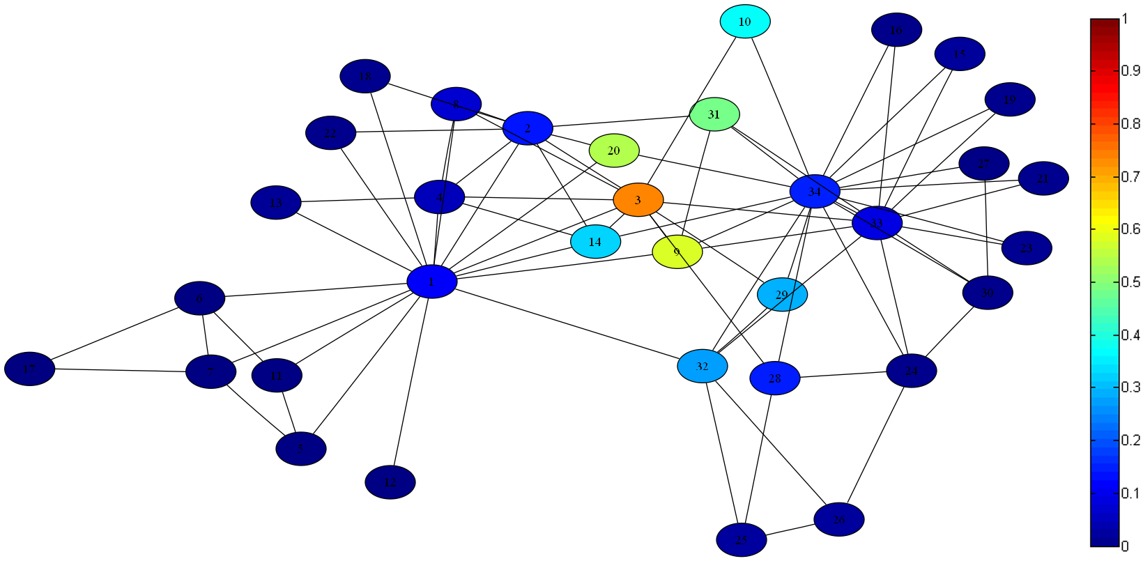
Fig. 2. The karate club network, colors represent the overlap index from each node, detected by the proposed method.

Slide 20
Conclusions
The algorithm outputs not only hard labels, but also soft labels (fuzzy values) for each node in the network, which corresponds to the levels of membership from that node to each community.
Computer simulations were performed in both synthetic and real data, and the results shows that our model is a promising mechanism to uncover overlap community structure in complex networks.

Slide 21
Uncovering Overlap Community Structure in Complex Networks using Particle Competition
International Conference on Artificial Intelligence and Computational Intelligence - AICI'09
Fabricio A. Breve fabricio@icmc.usp.br
Liang Zhao zhao@icmc.usp.br
Marcos G. Quiles quiles@icmc.usp.br
Department of Computer Science. Institute of Mathematics and Computer Science. University of São Paulo. São Carlos-SP. Brazil

