Slide 1




Particle Competition and Cooperation to Prevent Error Propagation from
Mislabeled Data in Semi-Supervised Learning
2012 Brazilian Symposium on Neural Networks - SBRN
Fabricio Breve^{1,2} fabricio@rc.unesp.br
Liang Zhao² zhao@icmc.usp.br
¹ Department of Statistics, Applied Mathematics and Computation (DEMAC), Institute of Geosciences and Exact Sciences (IGCE), São Paulo State University (UNESP), Rio Claro, SP, Brazil
² Department of Computer Science, Institute of Mathematics and Computer Science (ICMC), University of São Paulo (USP), São Carlos, SP, Brazil

Slide 2
Outline
Learning from Imperfect Data
The Proposed Method
Computer Simulations
Conclusions

Slide 3
Learning from Imperfect Data
In Supervised Learning
  Quality of the training data is very important
  Most algorithms assume that the input label information is completely reliable
  In practice mislabeled samples are common in data sets.

Slide 4
Learning from Imperfect Data
In Semi-Supervised learning
  Problem is more critical
    Small subset of labeled data
    Errors are easier to be propagated to a large portion of the data set
  Besides its importance and vast influence on classification, it gets little attention from researchers
[4] D. K. Slonim, “Learning from imperfect data in theory and practice,” Cambridge, MA, USA, Tech. Rep., 1996.
[5] T. Krishnan, “Efficiency of learning with imperfect supervision,” Pattern Recogn., vol. 21, no. 2, pp. 183–188, 1988.
[6] P. Hartono and S. Hashimoto, “Learning from imperfect data,” Appl. Soft Comput., vol. 7, no. 1, pp. 353–363, 2007.
[7] M.-R. Amini and P. Gallinari, “Semi-supervised learning with an imperfect supervisor,” Knowl. Inf. Syst., vol. 8, no. 4, pp. 385–413, 2005.
[8] ——, “Semi-supervised learning with explicit misclassification modeling,” in IJCAI’03: Proceedings of the 18th international joint conference on Artificial intelligence. San Francisco, CA, USA: Morgan Kaufmann Publishers Inc., 2003, pp. 555–560.

Slide 5
Proposed Method
Particles competition and cooperation in networks
  Cooperation among particles representing the same team (label / class)
  Competition for possession of nodes of the network
Each team of particles…
  Tries to dominate as many nodes as possible in a cooperative way
  Prevents intrusion of particles from other teams

Slide 6
Initial Configuration
An undirected network is generated from data by connecting each node to its k-nearest neighbors
  Labeled nodes are also connected to all other nodes with the same label
A particle is generated for each labeled node of the network
Particles initial position are set to their corresponding nodes
Particles with same label play for the same team
4

Slide 7
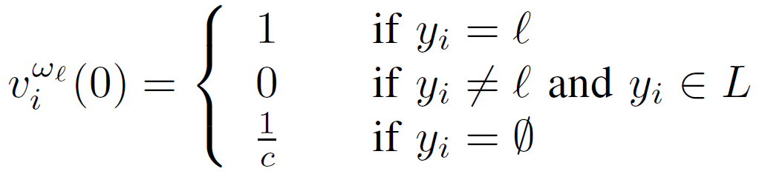
Initial Configuration
Nodes have a domination vector
  Labeled nodes have ownership set to their respective teams.
  Unlabeled nodes have levels set equally for each team
    Ex: [ 1.00 0.00 0.00 0.00 ]
    (4 classes, node
    labeled as class A)
    Ex: [ 0.25 0.25 0.25 0.25 ]
    (4 classes, unlabeled node)

Slide 8
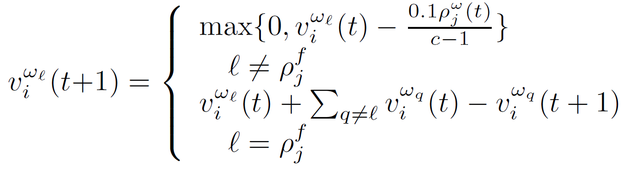
Node Dynamics
When a particle selects a neighbor to visit:
  It decreases the domination level of the other teams
  It increases the domination level of its own team
t
t+1

Slide 9

Particle Dynamics
0.6
A particle gets:
  stronger when it selects a node being dominated by its team
  weaker when it selects node dominated by other teams
0.1
0.2
0.1
0.4
0.3
0.2
0.1

Slide 10
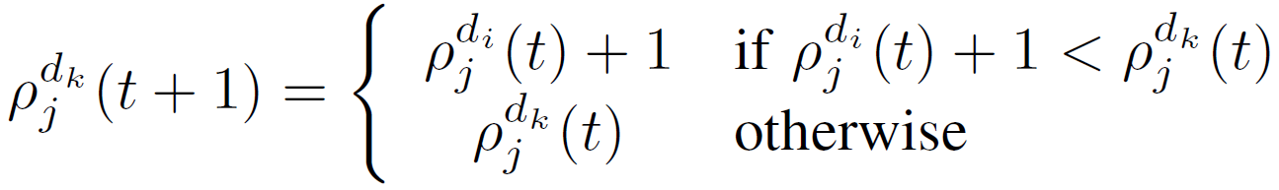
Distance Table
0
Keep the particle aware of how far it is from the closest labeled node of its team (class)
  Prevents the particle from losing all its strength when walking into enemies neighborhoods
  Keep them around to protect their own neighborhood.
Updated dynamically with local information
  Does not require any prior calculation
1
1
2
4
2
3
3
4
?
4

Slide 11
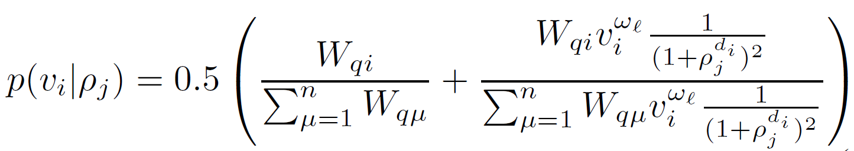
Particles Walk
  Random-greedy walk
    The particle will prefer visiting nodes that its team already dominates and nodes that are closer to the labeled nodes of its team (class)

Slide 12
0.6
Moving Probabilities
0.1
0.2
0.1
v₂
v₂
v₄
0.4
0.3
0.2
0.1
v₁
v₃
0.8
v₃
0.1
0.1
0.0
v₄

Slide 13
Particles Walk
Shocks
  A particle really visits the selected node only if the domination level of its team is higher than others;
  otherwise, a shock happens and the particle stays at the current node until next iteration.

Slide 14
Computer Simulations
Pairs of nodes which belong to the same class are linked with probability p_{in},
Pairs belonging to different classes are connected with probability p_{out}.
Average degree is defined by <k>.
Value of p_{out} is taken so the average number of links from a node to the nodes of any other classes, z_{out}, can be controlled.
Value of p_{in} is chosen to keep the average node degree <k> constant.
z_{out} / <k> defines the mixture of the classes
  as it increases from zero, the classes become more diffuse and harder to identify
[12] L. Danon, A. Díaz-Guilera, J. Duch, and A. Arenas, “Comparing community structure identification,” Journal of Statistical Mechanics: Theory and Experiment, vol. 9, p. P09008, 2005.

Slide 15
Computer Simulations
Network are generated with:
  Different sizes and average node degrees
  Elements divided into 4 classes
  25% of the edges are connecting different classes nodes
  Set of nodes N
  Labeled subset L ⊂ N
  Mislabeled subset Q ⊂ L ⊂ N

Slide 16
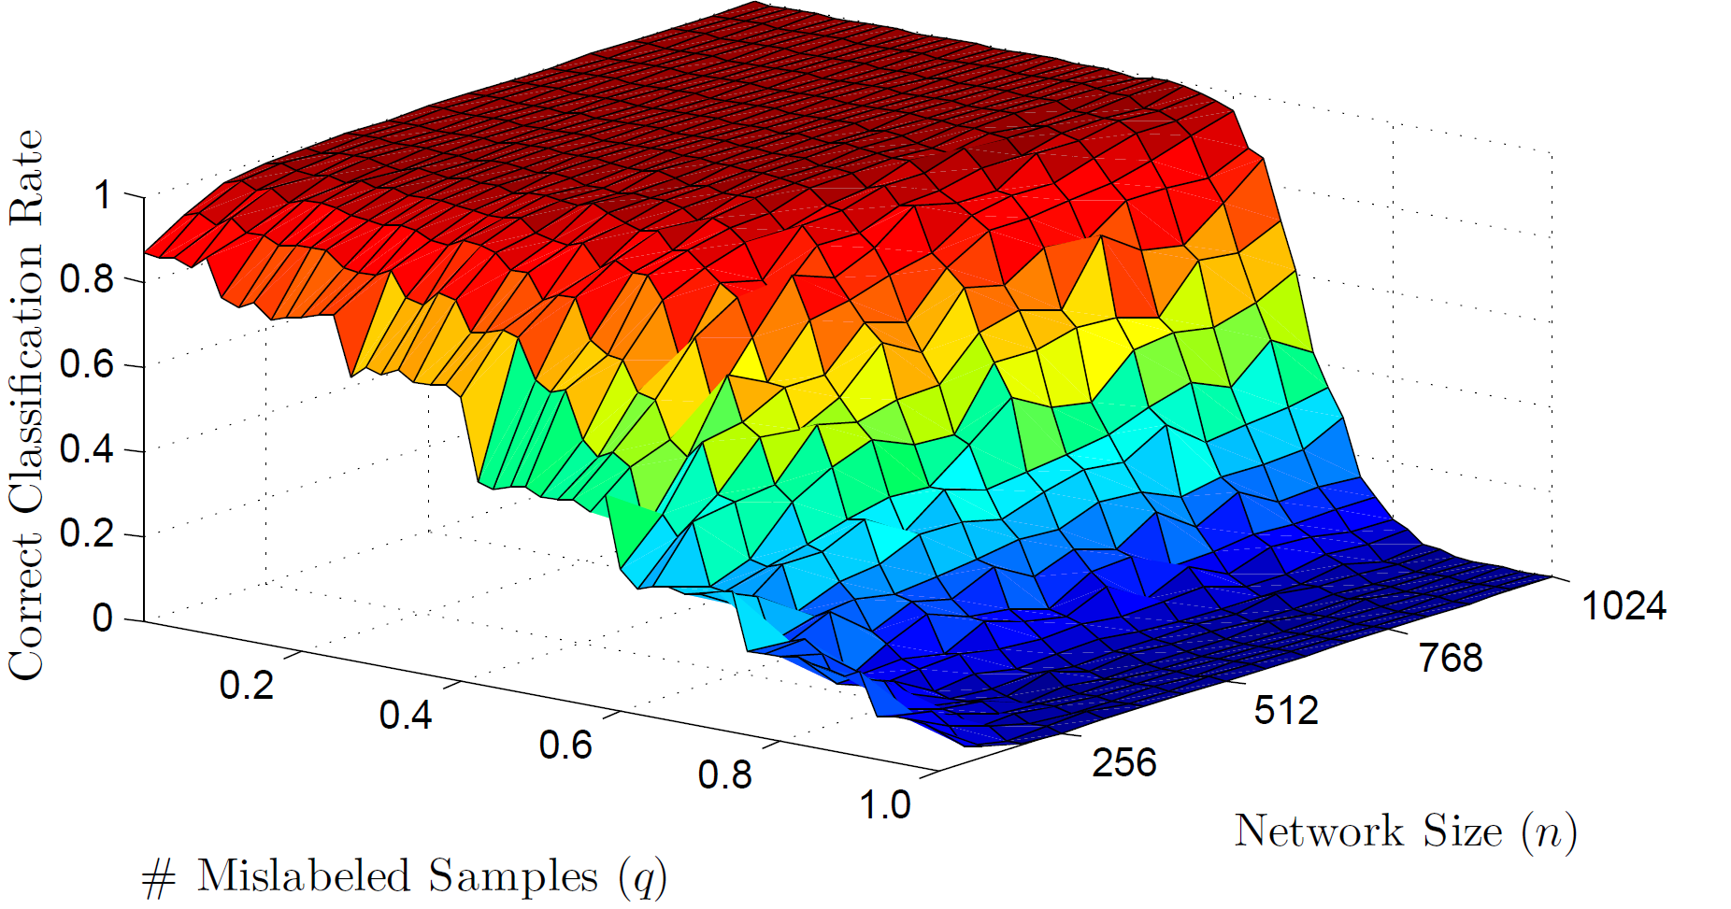
Correct Classification Rate with different network sizes and mislabeled subset sizes, ⟨k⟩ = n/8, l=n/0.1

Slide 17
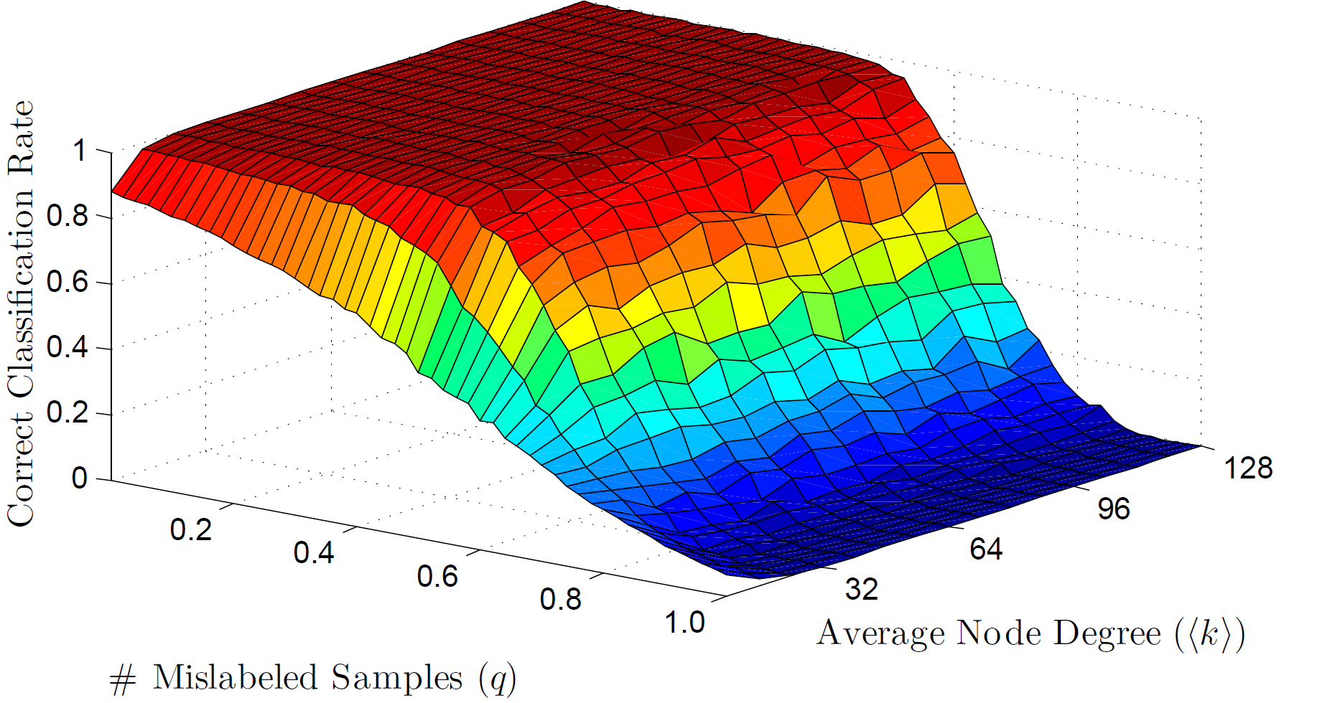
Correct Classification Rate with different average node degrees and mislabeled subset sizes, n = 512, l = 64.

Slide 18
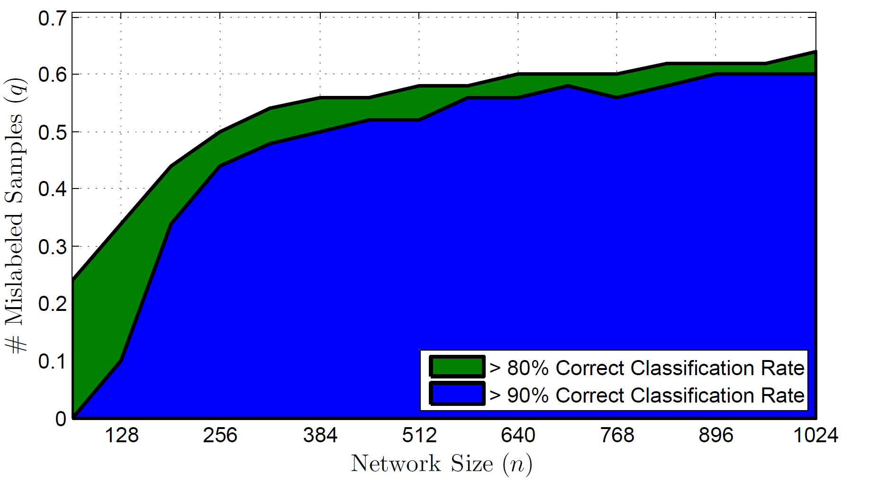
Maximum mislabeled subset size for 80% and 90% of correct classification rate with different network sizes, <k> = n/8, z_{out}/<k> = 0.25, l/n = 0.1

Slide 19
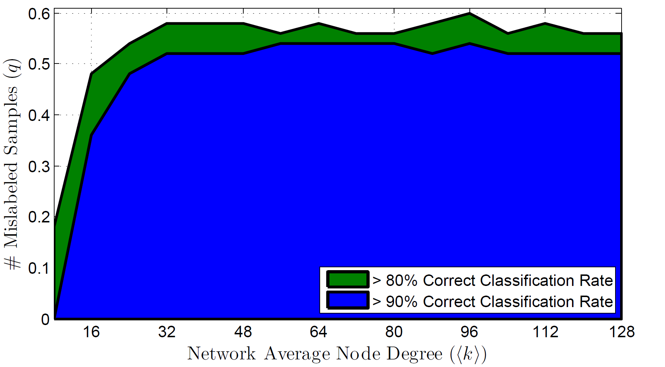
Maximum mislabeled subset size for 80% and 90% of correct classification rate with different network average node degree (⟨k⟩), n = 512, l/n = 0.1

Slide 20
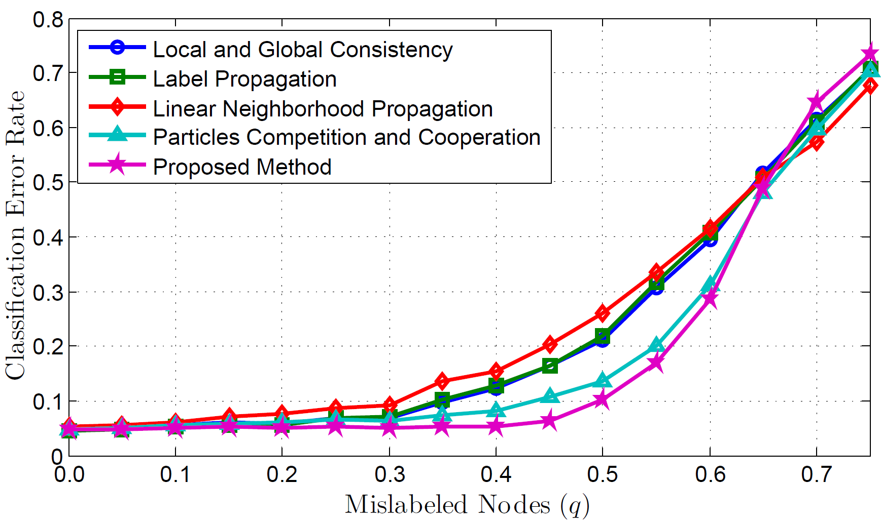
Classification error rate in a network with 4 normally distributed classes with different mislabeled subset size

Slide 21
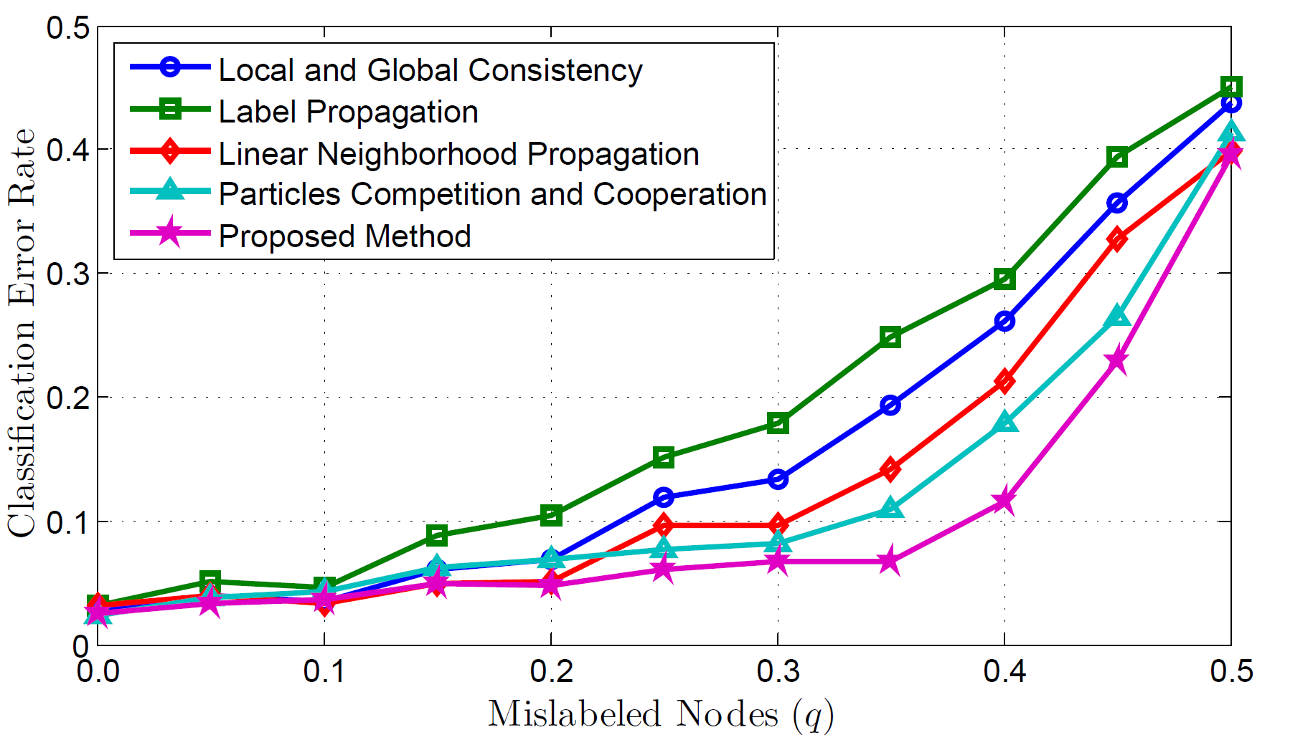
Classification error rate in the Digit1 data set with different mislabeled subset size

Slide 22
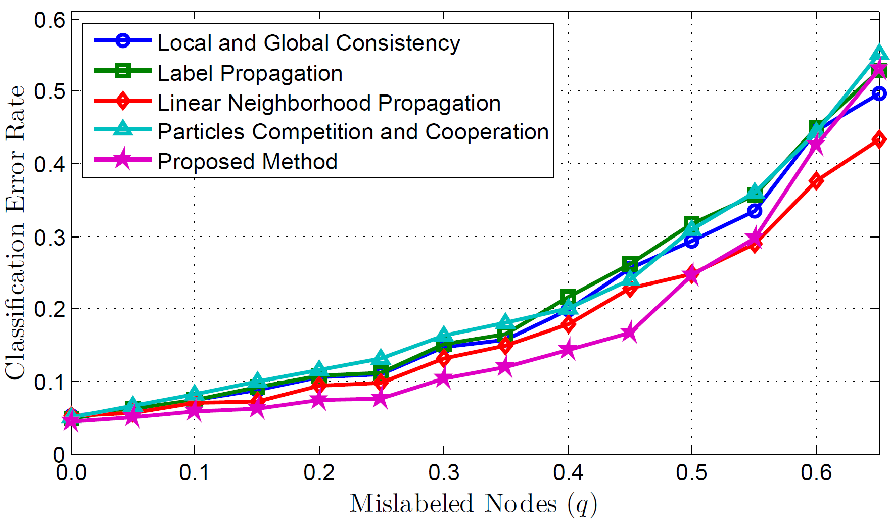
Classification error rate in the Iris data set with different mislabeled subset size
40 labeled samples

Slide 23
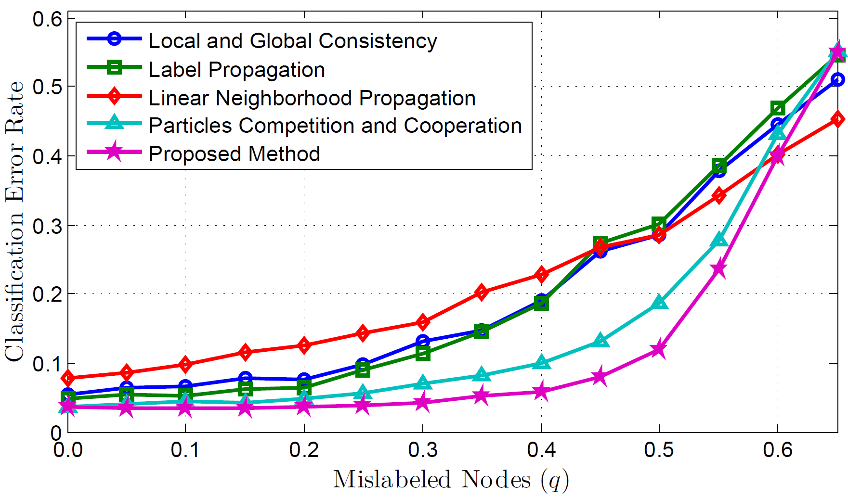
Classification error rate in the Wine data set with different mislabeled subset size
40 labeled samples

Slide 24
Conclusions
New biologically inspired method for semi-supervised classification
  Specifically designed to handle data sets with mislabeled subsets
    A mislabeled node may have its label changed when the team which has its correct label first dominates the nodes around it, then attacks it, and finally takes it over, thus stopping wrong label propagation from that node

Slide 25
Conclusions
Results analysis indicate the presence of critical points in the performance curve as the mislabeled samples subset grows.
  Related to the network size and average node degree.
Proposed algorithm
  Shows robustness in the presence of mislabeled data.
  Performed better than other representative graph-based semi-supervised methods when applied to artificial and real-world data sets with mislabeled samples.

Slide 26
Future Work
Expand the analysis to cover the impact of other networks measures in the algorithm performance
Expand the comparison to include more and larger data sets with mislabeled nodes

Slide 27


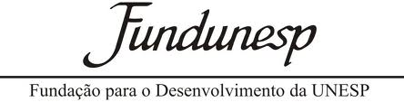
Acknowledgements
This work was supported by:
  State of São Paulo Research Foundation (FAPESP)
  Brazilian National Council of Technological and Scientific Development (CNPq)
  Foundation for the Development of Unesp (Fundunesp)

Slide 28
Particle Competition and Cooperation to Prevent Error Propagation from
Mislabeled Data in Semi-Supervised Learning
2012 Brazilian Symposium on Neural Networks - SBRN
Fabricio Breve^{1,2} fabricio@rc.unesp.br
Liang Zhao² zhao@icmc.usp.br
¹ Department of Statistics, Applied Mathematics and Computation (DEMAC), Institute of Geosciences and Exact Sciences (IGCE), São Paulo State University (UNESP), Rio Claro, SP, Brazil
² Department of Computer Science, Institute of Mathematics and Computer Science (ICMC), University of São Paulo (USP), São Carlos, SP, Brazil

